Slide 1
Beta burst analysis

Slide 2
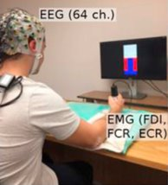
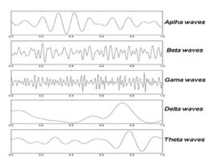
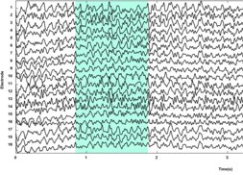
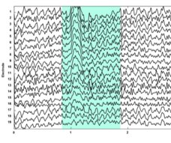
Data analysis
Data Preprocessing:
Bandpass filter (1-90 Hz)​
Visual inspection
Notch filter (60 Hz)​​
ICA for eye blinks and muscle artifacts
EEG & motor task
Raw signal
Pre-processed signal
Frequency analysis
Dal Maso et al., 2018
Notes:
I will now present the steps for my analysis. Offline EEG data preprocessing was performed using the Brainstorm MATLAB toolbox. EEG data was band-passed from 1Hz to 90Hz and referenced to the Cz electrode. Then, noisy epochs and channels (e.g., muscle, head, and jaw movement artifacts) were removed by visual inspection. Next, a notch filter was applied at 60Hz to remove power line artifacts. Finally, independent component analysis was used to identify and remove eye movement and some muscle artifacts.

Slide 3
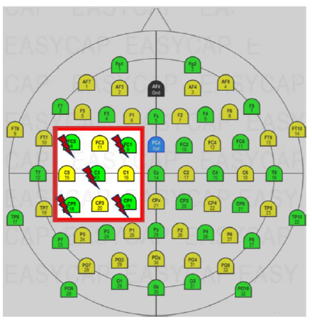
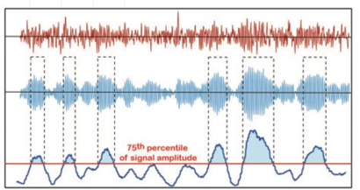

Data analysis
Frequency analysis
Statistical Analysis
Beta bursts
Tinkhauser et al., 2017
Notes:
~After the data has been pre-processed, beta bursts have been extracted from the resting-state periods and each trial of the motor tasks for the 9 electrodes in closest proximity to the stimulation electrodes. Statistical analysis is then performed on the different burst features extracted.
~EEG-based resting beta power, MRBD and beta bursts are extracted from data collected during the handgrip task using time-frequency analyses. Resting beta power and MRBD will be extracted by averaging the beta power across the 50 trials in the motor task. In each trial within the motor task, specific beta burst features will be extracted, namely the burst amplitude, burst duration, and burst frequency. ~Motor performance will be assessed as reaction time and task accuracy. Reaction time refers to the time it takes the participant to reach the target line at the beginning of each trial, while task accuracy refers to how far the movable indicator is from the target on average across trials. ~All these measures will then be compared using statistical analyses

Slide 4
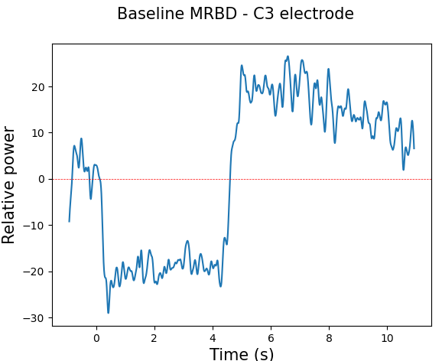
Beta burst extraction
Each motor epoch was divided into the following intervals:
[-1.1s, -0.1s] Pre-movement
[0.5s, 3.5s] Movement
[5s, 8s] Post-movement
For consistency, the resting state blocks were also separated into 3-second intervals.
PRE
MOV
POST
Notes:
In order to know which movement intervals to use for my beta burst analysis, I first plotted the MRBD plot averaged across all motor trials. The post-movement beta rebound after movement termination is known to overshoot the baseline and slowly decrease in power over the next 10-15sec. Unfortunately, as it can be seen, the beta rebound does not return to baseline before the next trial starts. I originally planned on having 3-second intervals for all movement intervals for consistency. However, I cannot use a long interval for pre-movement since the data would be contaminated by the post-movement rebound. Thus, a 1-second interval was used for pre-movement and 3-second intervals were used for movement and post-movement. ~ For consistency, the resting state blocks were also separated into 3-second intervals.
only show C3 + show on the figure the movement intervals chosen
electrodes above M1

Slide 5
Threshold method
For each motor epoch and resting state block:
Bandpass filter the signal over the beta frequency range [15Hz, 29Hz]
Apply the Hilbert transform on the signal
Extract the envelope of the signal amplitude
Remove the linear trend in the signal
Tinkhauser et al., 2017
Notes:
Here are the steps for computing the threshold method:

Slide 6
Threshold method
For each interval of interest:
Compute the 75th percentile of signal amplitude as the burst detection threshold
Extract bursts that are at least 100ms-long above the threshold
Tinkhauser et al., 2017

Slide 7
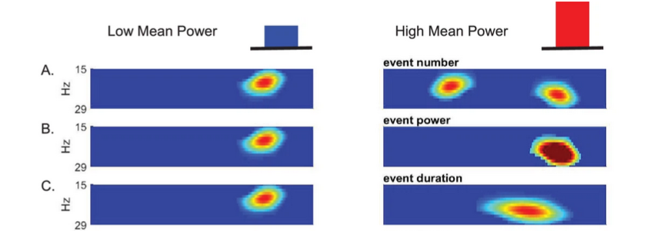
Beta Burst features
For each interval of interest, extract the following burst features:
Burst rate
Burst amplitude
Burst duration
Shin et al., 2017

Slide 8
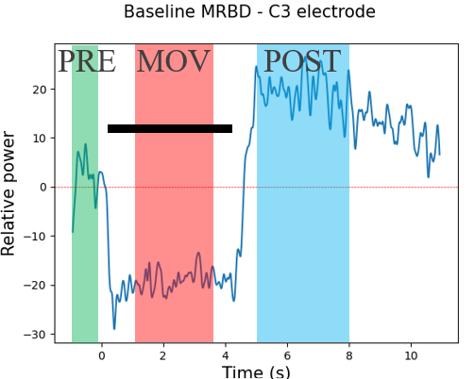
Underestimated bursts
Hypothesis: Bursts are underestimated when extracted from small intervals.
Extract all resting state data from all participants.
Divide all the data into intervals of sizes: [1, 2, 3, 4]s
Extract the burst rate from each interval of interest (1s, 2s, 3s, 4s)
Apply Bonferroni-corrected t-tests between each interval.
If bursts are correctly identified, there shouldn’t be any statistical difference between the 4 interval groups.
1 2 3 4 1 2 3 4 1 2 3 4
Notes:
While analyzing my data and testing preliminary results, I encountered an interesting problem that I didn’t see mentioned anywhere else. I observed that when extracting bursts from very small intervals, the bursts identified seem to be underrepresented compared to longer ones. This problem is significant to me because the pre-movement interval is only 1s long, while all other movement intervals are 3s long. In order to test formally test this hypothesis, ~ I extracted all resting state data from all participants. Then, I divide all the data into intervals of sizes: [1, 2, 3, 4], meaning that each group of intervals will repeat itself over and over again for all resting state blocks. ~ Then, I extract the burst rate from each interval and apply Bonferroni-corrected t-tests between the intervals. If bursts are correctly identified, there shouldn’t be any statistical difference between the 4 interval groups since all groups are taken from the resting state data.

Slide 9
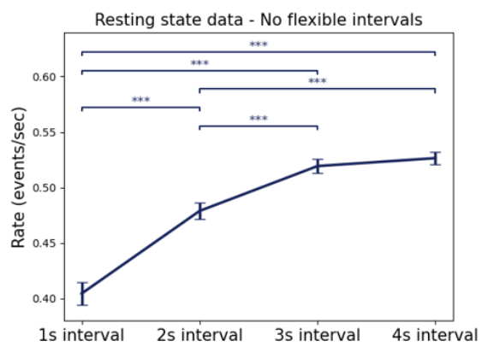
Underestimated bursts
Notes:
However, as I expected, smaller intervals are significantly underrepresented. We can see that the 1s and 2s intervals have a considerably smaller burst rate compared to the 3s and 4s ones.

Slide 10
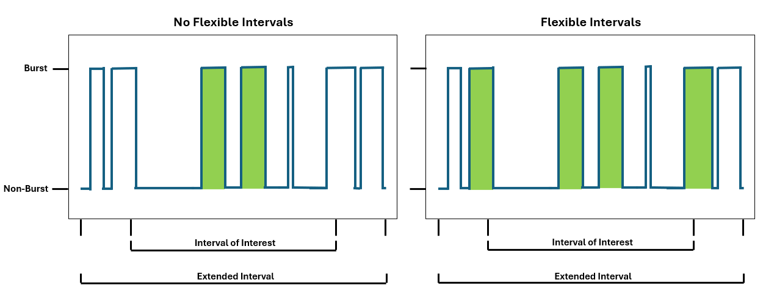
Flexible intervals
Hypothesis: Bursts are underestimated when extracted from small intervals.
Notes:
In order to solve this issue, I thought of a method that I would call flexible intervals. ~To illustrate it, consider the following 0.3s interval (left) that does not contain any bursts. ~ However, by considering 0.3s before and after this interval (right), we discover 2 bursts that would have been missed because the initial interval was too small. So, the idea of flexible intervals is to expand beyond the extremities of each interval of interest and assess whether or not there is a burst that would be missed otherwise. The difference between this and simply looking at a larger interval overall is that we only consider bursts that start or end within the original non-expanded interval of interest.

Slide 11
Flexible intervals (testing)
Extract all resting state data from all participants.
Divide all the data into intervals of sizes: [0.3, 1, 0.6, 2, 0.6, 3, 0.6, 4, 0.3]s
The short intervals (0.3s and 0.6s) are used to have no crossover between the intervals of interest when using flexible intervals.
Extract the burst rate from each interval of interest (1s, 2s, 3s, 4s) using no flexible intervals and using flexible intervals with 0.3s of data added on each extremity.
Apply paired Bonferroni-corrected t-tests between each interval.
If bursts are correctly identified, there shouldn’t be any statistical difference between the 4 interval groups.
1 2 3 4 1
Notes:
To test whether this method works, A similar test was done as before. The main difference is that the data was separated into extra intervals of 0.3s and 0.6s in order to have no crossover between the intervals of interest when using flexible intervals. ~Each flexible interval would be composed of the original interval plus 0.3s of data added on each extremity. ~ I Apply paired Bonferroni-corrected t-tests between each interval. ~If bursts are correctly identified, there shouldn’t be any statistical difference between the 4 interval groups.

Slide 12
Flexible intervals (testing)
Notes:
And indeed, we can see on the right figure that when flexible intervals are applied, all intervals of interest have similar burst rates, signifying no more bias over interval size.

Slide 13
Flexible intervals
No adjustments needed for the movement intervals since they are already separated
The 3-second resting-state intervals were readjusted to not overlap: [0.3, 3, 0.3]s
PRE
MOV
POST
Notes:
To summarize

